Slide 1


Slide 2
Agenda
Relational databases
Create a database and generate scripts
Database schemas
Keys and Constraints
CRUD Operations
JOINS
Views, Triggers
Group By, Order By, Having
Stored procedures, Transactions
Sql profiler, Execution plan
NoSql databases

Slide 3
Relational databases
A relational model of data in tables
Used for complex systems
Normalization in order to avoid data redundancy and improve data integrity

Slide 4
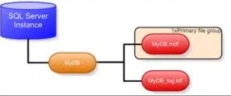
Create a database and generate scripts
Though a visual tool or programmatically
Information is kept in 2 files(*.LDF and *.MDF)
Restore, Detach, Take online/offline, Delete

Slide 5
Database schemas
By default.dbo
Users, roles and rights are per schema
Used to have a clear differentiation for specific functionalities

Slide 6
CRUD Operations
CREATE
READ
UPDATE
DELETE

Slide 7
SELECT
*(All) or specific columns
TOP Number rows
Distinct
Can be used with Aggregate Functions
With aliases
Can be applied to sub-selects or nested selects
UNION, INTERSECT
EXISTS, IN, NOT IN, LIKE

Slide 8
INSERT
Single row
Bulk insert
INSERT INTO… Select … FROM…

Slide 9
UPDATE
UPDATE table_name SET column1 = value1, column2 = value2, ... WHERE condition;

Slide 10
DELETE
DELETE FROM table_name WHERE condition;
Without WHERE condition all entries from tables are raised, but can be restored from LOGs
Use TRUNCATE TABLE to have PK reset
Cascade delete

Slide 11
Keys and Constraints
PK
UK
FK
Check constraint
Default constraint

Slide 12
Aggregate functions
https://www.sqlservertutorial.net/sql-server-aggregate-functions/
Most used: AVG, COUNT, MIN, MAX, SUM

Slide 13
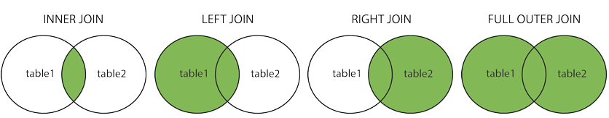
JOINS
(INNER) JOIN
LEFT (OUTER) JOIN
RIGHT (OUTER) JOIN
FULL (OUTER) JOIN

Slide 14
Group by, Having and Order by
SELECT
h.EmployeeId, COUNT(*)
FROM [dbo].[Employee] AS e
INNER JOIN [dbo].[Holiday] AS h ON e.[EmployeeId] = h.[EmployeeId]
INNER JOIN [dbo].Country AS c ON h.[CountryId] = c.[CountryId]
GROUP BY h.EmployeeId
HAVING COUNT(*) > 1
ORDER BY h.EmployeeId DESC

Slide 15
Views
CREATE VIEW [EmployeeHolidays2019] AS
SELECT e.[EmployeeId], ([FirstName] + ' ' + [LastName]) as [Name]
FROM [dbo].[Employee] AS e
INNER JOIN [dbo].[Holiday] AS h
on e.[EmployeeId] = h.[EmployeeId]
WHERE [HolidayStartDate] BETWEEN '1/1/2019' AND '12/31/2019'

Slide 16
Functions
Stored procedures

Slide 17
Transactions
Sql Injection
Sql Profiler
Execution plan

Slide 18
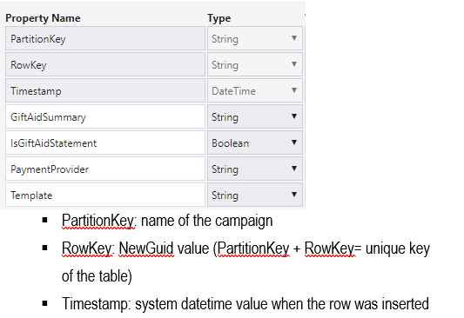
NoSql
Azure Table Storage

Slide 19
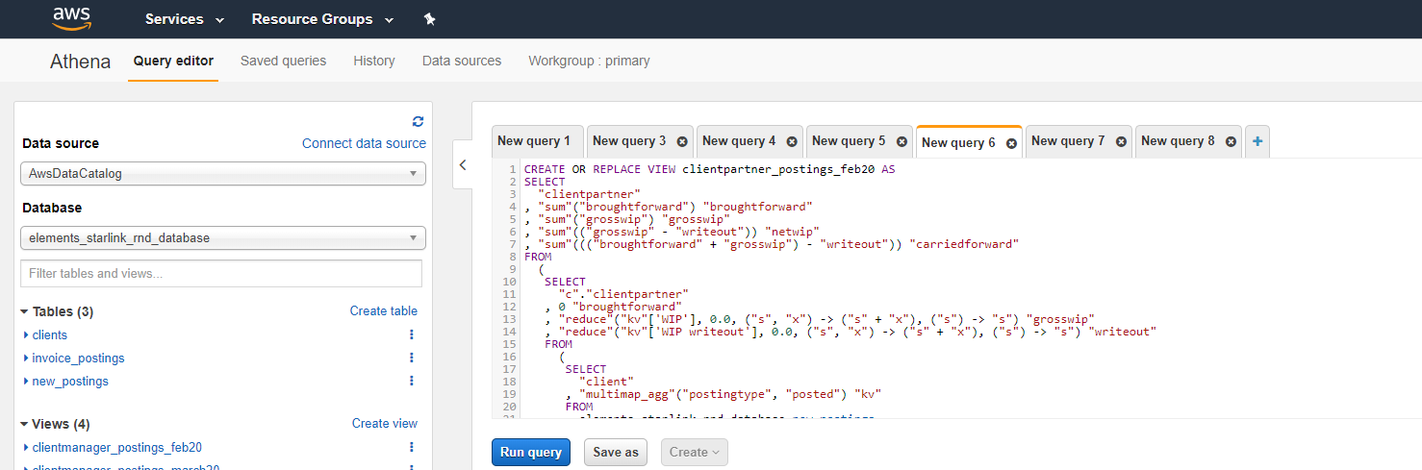
NoSql
Athena

